Slide 1

Airport System Simulation
Yahia Algasim
Abdurrahman Said
Hamza Srour Malah
Mahmoud Zain Sabto

Slide 2
What is our project about?
an airport operation, by providing essential needs to passengers and minimizing airport resources like time, finance, and Airport space.

Slide 3

What is Simio?
Simio is an application used to provide an actual virtual representation of all elements involved in an operation. It provides a platform where a system can be studied and optimized

Slide 4
Problem Statement
Number of bus stops and metal detecting scanners needed to maintain a quick and safe entrance to the airport.
Number of waiting areas, restrooms, and restaurants/coffeehouses needed to accommodate the number of people at the airport.
Number of ticketing and passport control counters needed.
Number of boarding areas.
Number of runways and airplane offloading area.
Number of passport control counters for arrivals.
Combining the Luggage with the passenger after arriving.

Slide 5
What are airports requirements ?
Bus stops
Restaurants
Restrooms
Coffeeshops
Waiting areas
Metal detecting scanner
Boarding stations
Passport control stations
Runways

Slide 6
Methodological Approach
Simio is an application used to provide an actual virtual representation of all elements involved in an operation.
Takt time method is a simple process that determines the required number of workers/servers, using the processing time of each step and the available time at hand, while considering the required number of units that need to be produced.
Simulation using the Simio application
Takt time method

Slide 7
Assumption and constraints
Assumptions and constraints that we used in our project for the number of people:
Number of passengers
Number of passenger’s relatives or Number of people not traveling
Number of passengers using bus
Mean Passengers of transport passengers use to the airport

Slide 8

Assumption and Constraints
Assumptions and constraints that we used in our project for process time:
Bus offloading
Waiting area
Restaurants & coffeehouses
Restrooms
Ticketing counters
Passport control
Runways
Airplane offloading
Luggage offloading

Slide 9
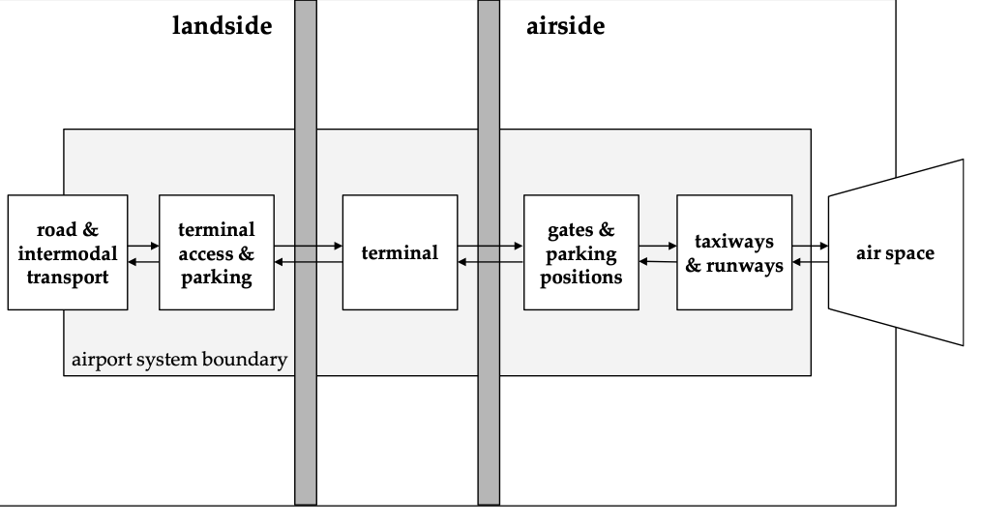
Airport Structures
Airport structure defines and synchronizes all airport operations, although “the various processes bring multiple of players whose jurisdictions is to deliver parts of the required services The airport players are landslide and airside.

Slide 10
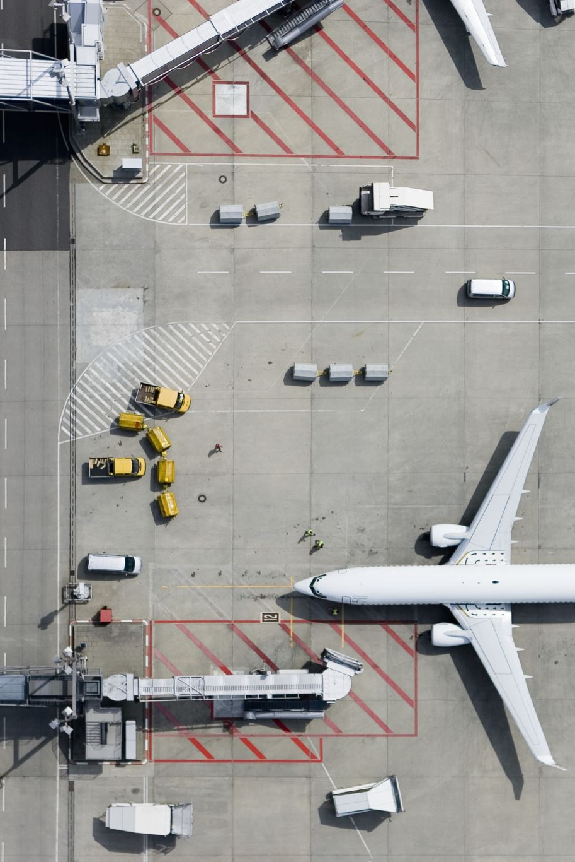
International airports
They are defined by their customs facilities, which frequently necessitate a higher level of physical protection. In most cases, international airports contain a complex of facilities where passengers may board planes and goods can be stored and loaded

Slide 11
Airport Operations
A vast team of personnel works together outside the terminal to guarantee that planes can land, take off, and move around promptly and safely. Passengers are typically unaware of these processes, yet they are extremely sophisticated at large airports.
So, lets mention some of the Airport Operations:
Aircraft maintenance
Pilot services
Aircraft rental and hangar rental are most often performed by a fixed base operator (FBO). At major airports, particularly those used as hubs, airlines may operate their support facilities.

Slide 12
Simulation Aspects
Calculations; calculating the required number of servers.
Entity routing; methods of routing entities to servers.
Algorithms; methods of applying algorithms to SIMIO.

Slide 13
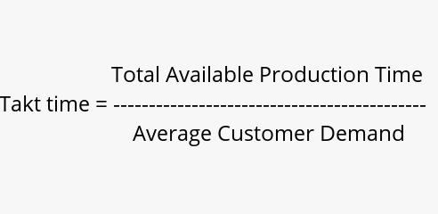
Simulation Calculations
Takt time:
Takt time method is most suitable for determining the required number of servers to suffice needs.

Slide 14
Simulation Entity Routing
Selection weight method
Selecting from a node list
If-else function value-based method

Slide 15
Simulation Algorithms
Addon processes are used to write the logic in SIMIO:
Decide: used to decide if a value is true or not; "if-else".
Assign: used to assign a value to an integer.
Set-node: used to set a specific node for entities to go to.

Slide 16
Problems Encountered
Some issues were encountered that resulted in simulating the airport in five separate files:
The student version of SIMIO is limited to only 150 logic steps (add-on process steps).
The student version of SIMIO is limited to only 200 elements.
Implementing the node list method in some cases will crash the application; due to a large number of entities at a certain time.

Slide 17
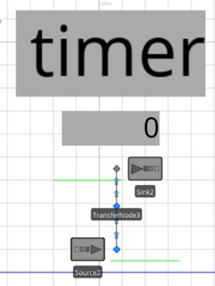
Problems Encountered
There were some difficulties in constructing a timer function for SIMIO to recognize the starting time and ending time for each flight, so we devolved a timer of our own.

Slide 18
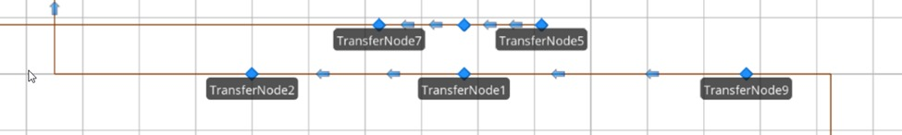
Discovered SIMIO Bugs
SIMIO will skip or even neglect some logical steps in case the path between transfer nodes is short.

